Slide 1

TARGET FOLDER
SRNTGT004
Olenya Airbase
OPAC CLASSIFIED
REL TO CJTF-23
OPAC CLASSIFIED
REL TO CJTF-23

Slide 2
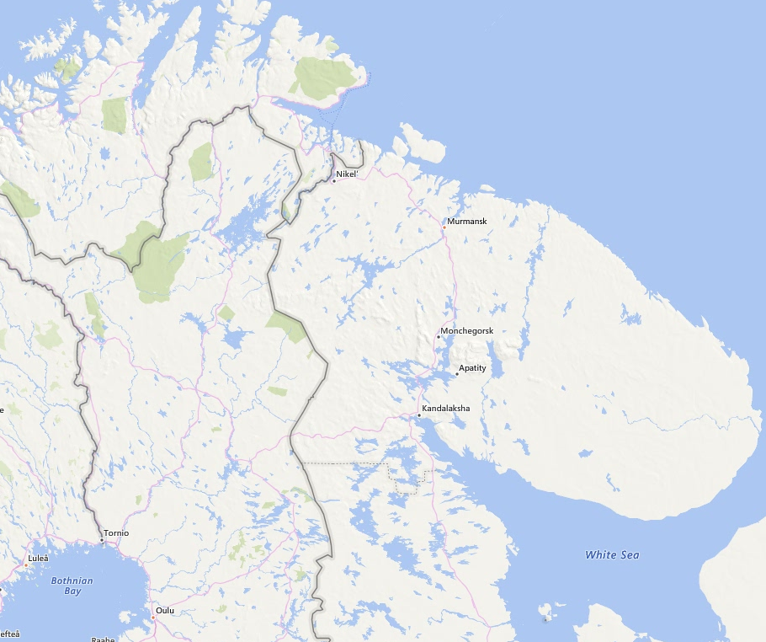
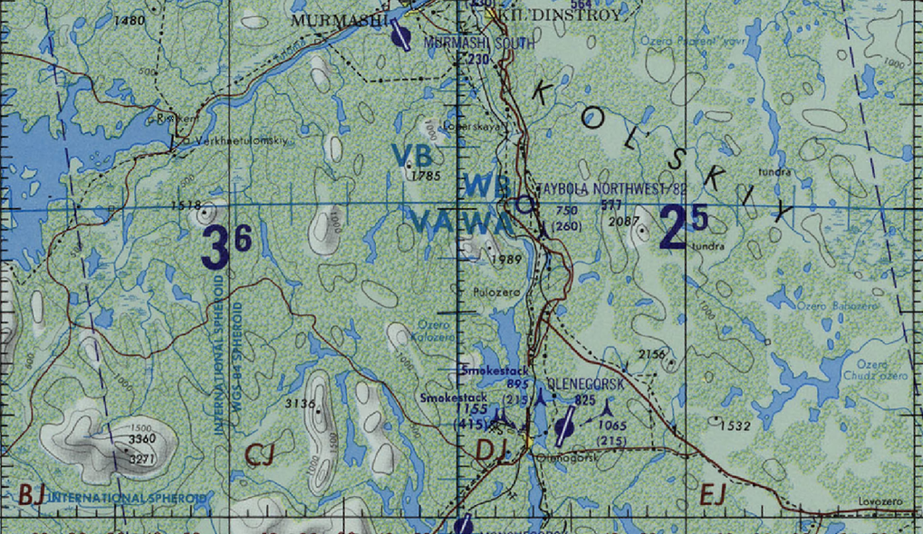
 | OLENYA AIRBASE, SRN JOINT OPERATIONS GRAPHIC 1/1 | MAP OVERVIEW | OPAC CLASSIFIED REL TO CJTF-23
 | BE:SRNTGT004 CATCODE: 3 MIDB GEO: N 68 09.089 E 033 27.834 ICOD: 2011-07-01 DOI: 2011-05-12 |  | DECL ON: 2061-01-01(+50 YEARS)
OPAC CLASSIFIED
N
Olenya Airbase
SRNTGT004
.
OPAC CLASSIFIED
REL TO CJTF-23

Slide 3
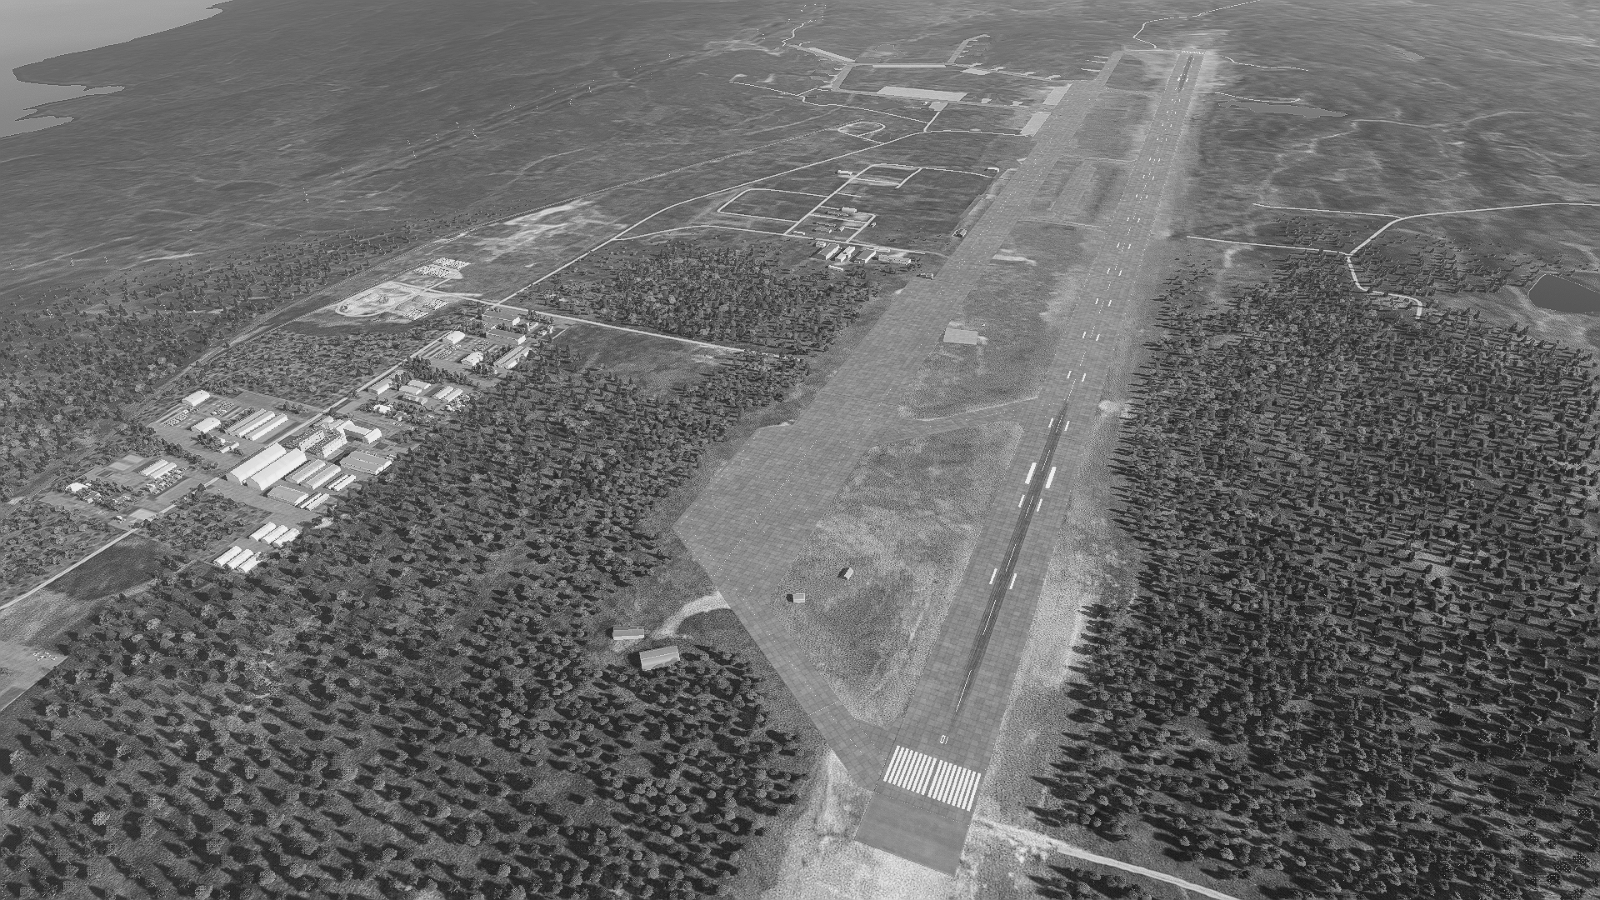
 | OLENYA AIRBASE, SRN FACILITY OUTLINE GRAPHIC 1/1 | MAP OVERVIEW | OPAC CLASSIFIED REL TO CJTF-23
 | BE:SRNTGT004 CATCODE: 3 MIDB GEO: N 68 09.089 E 033 27.834 ICOD: 2011-07-01 DOI: 2011-05-12 |  | DECL ON: 2061-01-01(+50 YEARS)
OPAC CLASSIFIED
N
OPAC CLASSIFIED
REL TO CJTF-23

Slide 4
 | OLENYA AIRBASE, SRN COLLOCATED FACILITY GRAPHIC 1/1 | MAP OVERVIEW | OPAC CLASSIFIED REL TO CJTF-23
 | BE:SRNTGT004 CATCODE: 3 MIDB GEO: N 68 09.089 E 033 27.834 ICOD: 2011-07-01 DOI: 2011-05-12 |  | DECL ON: 2061-01-01(+50 YEARS)
OPAC CLASSIFIED REL TO CJTF-23
N
OLENOGORSK WEST MISSILE FACTORY
SRNTGT102
OPAC CLASSIFIED
REL TO CJTF-23

Slide 5
 | OLENYA AIRBASE, SRN JOINT DESIRED POINT OF IMPACT GRAPHIC 1/2 | MAP OVERVIEW | OPAC CLASSIFIED REL TO CJTF-23
 | BE:SRNTGT004 CATCODE: 3 MIDB GEO: N 68 46.936 E 032 44.996 ICOD: 2011-07-01 DOI: 2011-05-12 |  | DECL ON: 2061-01-01(+50 YEARS)
OPAC CLASSIFIED
DPI A
N
DPI B
DPI C
DPI: SRNTGT004A
RUNWAY NORTH
N 68 09.596 E 033 28.321
DPI MSL: 716 FT
DPI: SRNTGT004B
RUNWAY CENTRE
N 68 08.973 E 033 27.728
DPI MSL: 685 FT
DPI: SRNTGT004C
RUNWAY SOUTH
N 68 08.566 E 033 27.345
DPI MSL: 716 FT
OPAC CLASSIFIED
REL TO CJTF-23

Slide 6
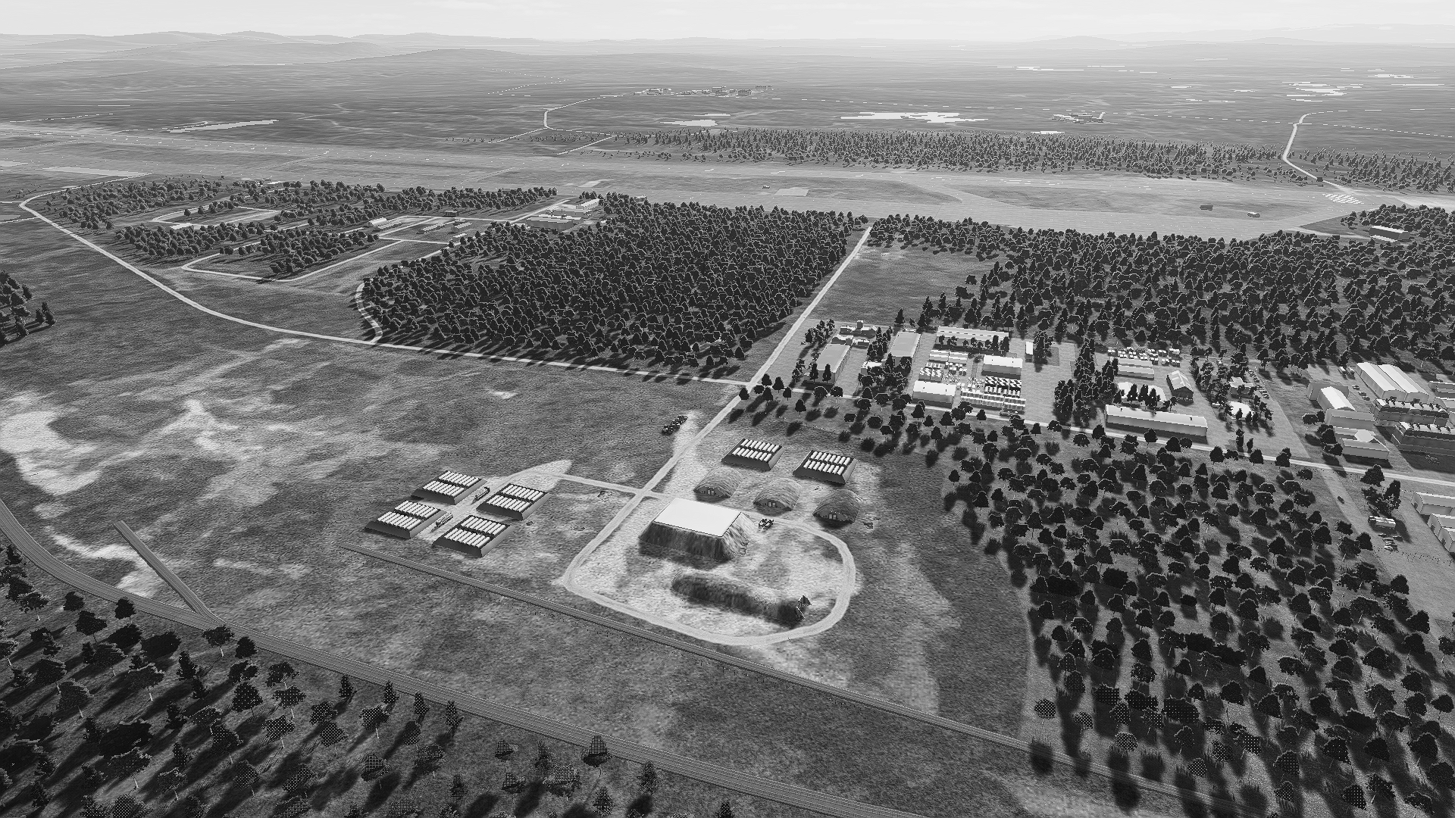
 | OLENYA AIRBASE, SRN JOINT DESIRED POINT OF IMPACT GRAPHIC 2/2 | MAP OVERVIEW | OPAC CLASSIFIED REL TO CJTF-23
 | BE:SRNTGT004 CATCODE: 3 MIDB GEO: N 68 46.936 E 032 44.996 ICOD: 2011-07-01 DOI: 2011-05-12 |  | DECL ON: 2061-01-01(+50 YEARS)
OPAC CLASSIFIED
N
DPI D
DPI H
DPI G
DPI E
DPI K
DPI: SRNTGT002N
AMMO STORAGE ON GND
N 68 08.740 E 033 25.584
DPI MSL: 633 FT
DPI M
DPI: SRNTGT002M
AMMO STORAGE ON GND
N 68 08.725 E 033 25.706
DPI MSL: 642 FT
DPI I
DPI F
DPI J
DPI: SRNTGT002L
AMMO STORAGE ON GND
N 68 08.742 E 033 25.726
DPI MSL: 642 FT
DPI: SRNTGT002D
FUEL STORAGE ON GND
N 68 08.747 E 033 25.814
DPI MSL: 649 FT
DPI N
DPI L
DPI: SRNTGT002E
FUEL STORAGE ON GND
N 68 08.722 E 033 25.786
DPI MSL: 651 FT
DPI: SRNTGT002F
FUEL STORAGE ON GND
N 68 08.836 E 033 25.683
DPI MSL: 633 FT
DPI: SRNTGT002G
FUEL STORAGE ON GND
N 68 08.827 E 033 25.736
DPI MSL: 633 FT
DPI: SRNTGT002H
FUEL STORAGE ON GND
N 68 08.851 E 033 25.764
DPI MSL: 631 FT
DPI: SRNTGT002I
FUEL STORAGE ON GND
N 68 08.859 E 033 25.711
DPI MSL: 628 FT
DPI: SRNTGT002J
AMMO STORAGE ON GND
N 68 08.767 E 033 25.687
DPI MSL: 638 FT
DPI: SRNTGT002K
AMMO STORAGE ON GND
N 68 08.762 E 033 25.748
DPI MSL: 641 FT
OPAC CLASSIFIED
REL TO CJTF-23

Slide 7
 | OLENYA AIRBASE, SRN WEAPONEERING OPTIONS 1/1 | MAP OVERVIEW | OPAC CLASSIFIED REL TO CJTF-23
 | BE:SRNTGT004 CATCODE: 3 MIDB GEO: N 68 46.936 E 032 44.996 ICOD: 2011-07-01 DOI: 2011-05-12 |  | DECL ON: 2061-01-01(+50 YEARS)
OPAC CLASSIFIED
DPI | DESCRIPTION | TLE | WARHEAD | GUIDANCE | DESIRED EFFECT | IMPACT ANGLE | FUZING
A | RUNWAY | CATI | AS REQUIRED | METRIC | CRATER | 90° | 25ms
B | RUNWAY | CATI | AS REQUIRED | METRIC | CRATER | 90° | 25ms
C | RUNWAY | CATI | AS REQUIRED | METRIC | CRATER | 90° | 25ms
D | FUEL STORAGE | CATI | 1x 2000lb | METRIC | BLAST, INCENDIARY | 90° | 10ms
E | FUEL STORAGE | CATI | 1x 2000lb | METRIC | BLAST, INCENDIARY | 90° | 10ms
F | FUEL STORAGE | CATI | 1x 2000lb | METRIC | BLAST, INCENDIARY | 90° | 10ms
G | FUEL STORAGE | CATI | 1x 2000lb | METRIC | BLAST, INCENDIARY | 90° | 10ms
H | FUEL STORAGE | CATI | 1x 2000lb | METRIC | BLAST, INCENDIARY | 90° | 10ms
I | FUEL STORAGE | CATI | 1x 2000lb | METRIC | BLAST, INCENDIARY | 90° | 10ms
J | AMMO STORAGE | CATI | 1x 1000lb | METRIC | BLAST | 90° | 10ms
K | AMMO STORAGE | CATI | 1x 500lb | METRIC | BLAST | 90° | 10ms
L | AMMO STORAGE | CATI | 1x 500lb | METRIC | BLAST | 90° | 10ms
M | AMMO STORAGE | CATI | 1x 500lb | METRIC | BLAST | 90° | 10ms
N | AMMO STORAGE | CATI | 1x 2000lb | METRIC | BLAST | 90° | 25ms
OPAC CLASSIFIED

Slide 8
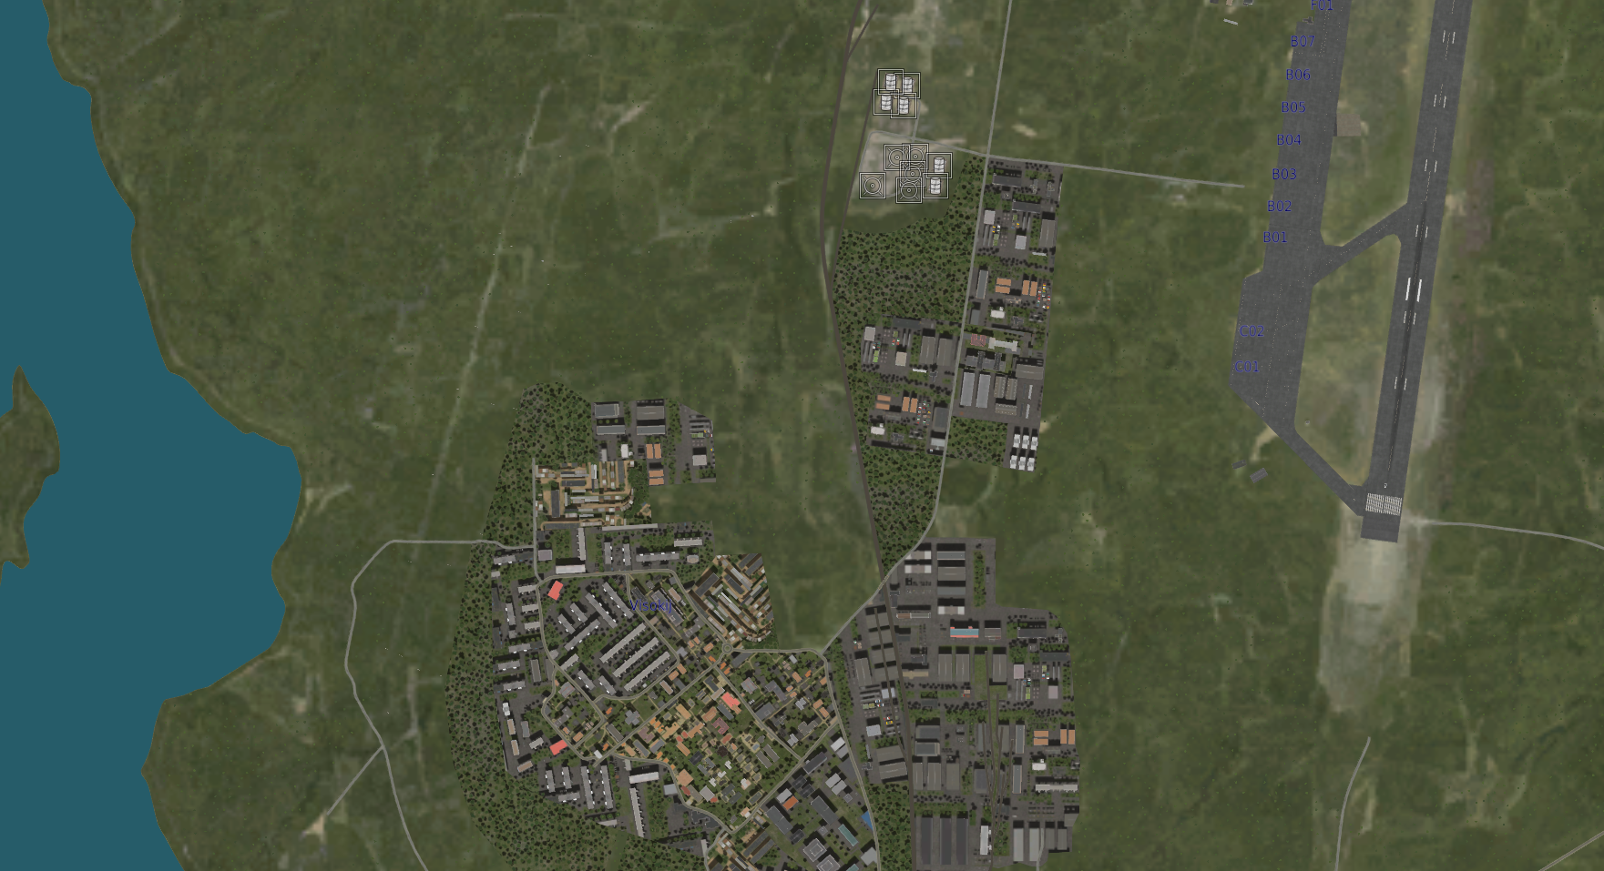
 | OLENYA AIRBASE, SRN COLLATERAL DAMAGE ESTIMATION GRAPHIC | MAP OVERVIEW | OPAC CLASSIFIED REL TO CJTF-23
 | BE:SRNTGT004 CATCODE: 3 MIDB GEO: N 68 46.936 E 032 44.996 ICOD: 2011-07-01 DOI: 2011-05-12 |  | DECL ON: 2061-01-01(+50 YEARS)
OPAC CLASSIFIED
SRNTGT004N
CER 265M / 869ft
N
NCC: WAREHOUSE
2400 FT SW FROM SRNTGT004N
19600 SQ FT
OPAC CLASSIFIED
REL TO CJTF-23
CDE 4

Slide 9
 | OLENYA AIRBASE, SRN COLLATERAL DAMAGES ESTIMATION 1/1 | MAP OVERVIEW | OPAC CLASSIFIED REL TO CJTF-23
 | BE:SRNTGT004 CATCODE: 3 MIDB GEO: N 68 46.936 E 032 44.996 ICOD: 2011-07-01 DOI: 2011-05-12 |  | DECL ON: 2061-01-01(+50 YEARS)
OPAC CLASSIFIED
COLLATERAL DAMAGES WITHIN A 500M RADIUS
DESCRIPTION |  | CATCODE | MIDB GEOS | LOCATION | REMARKS
NO STRIKE ENTITIES WITHIN A 500M RADIUS
NSE ID | DESCRIPTION | CATCODE | MIDB GEOS | LOCATION | REMARKS
NONE
OPAC CLASSIFIED
REL TO CJTF-23

Slide 10
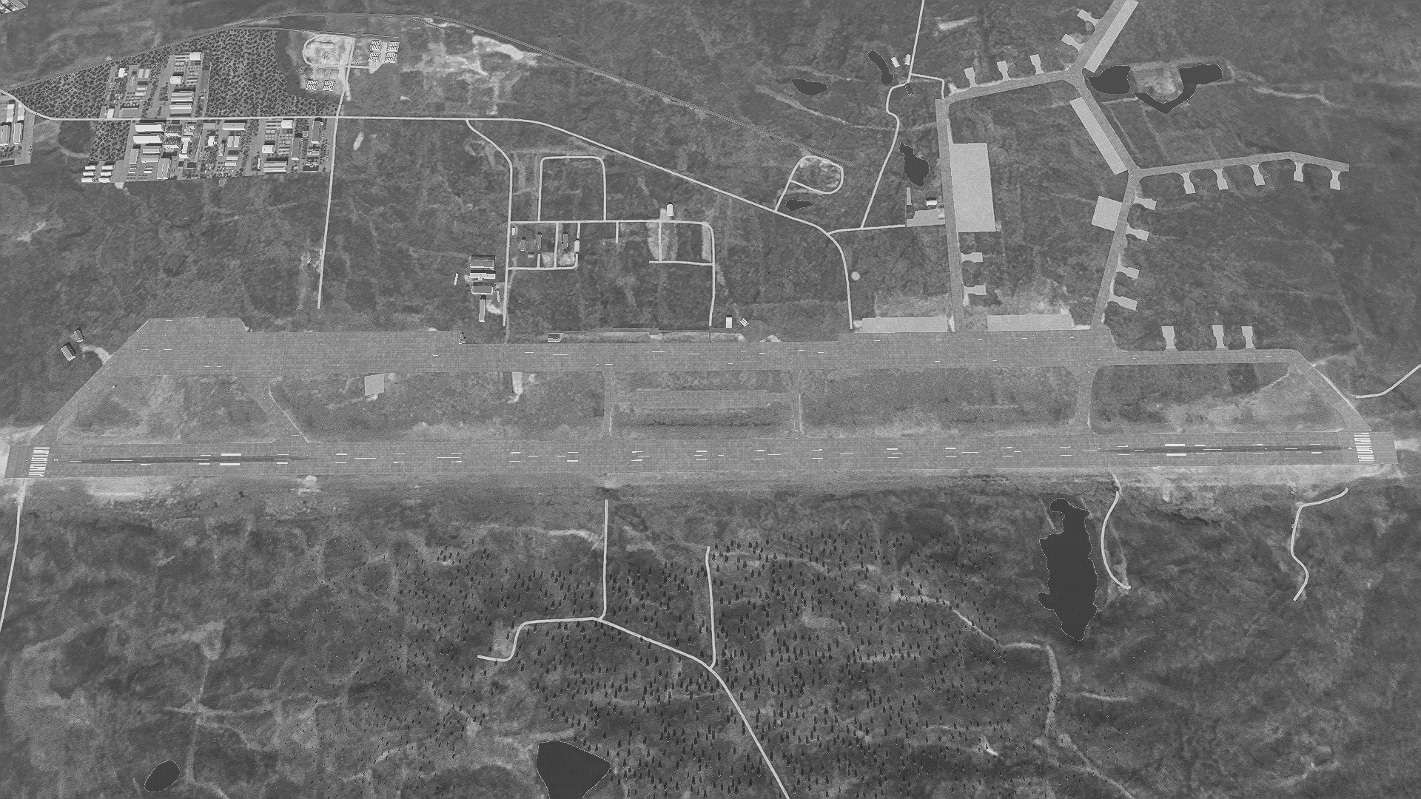
 | OLENYA AIRBASE, SRN BATTLE DAMAGE ASSESSMENT GRAPHIC [X] | MAP OVERVIEW | OPAC CLASSIFIED REL TO CJTF-23
 | BE:SRNTGT004 CATCODE: 3 MIDB GEO: N 68 46.936 E 032 44.996 ICOD: 2011-07-01 DOI: 2011-05-12 |  | DECL ON: 2061-01-01(+50 YEARS)
OPAC CLASSIFIED
POST-STRIKE
PRE-STRIKE
N
TARGET OBJECTIVE
DAMAGE/CHANGE ASSESSMENT
DPI:[XXXXXX]
OPAC CLASSIFIED
REL TO CJTF-23
BDA REMARK: OPAC CLASSIFIED REL TO CJTF-23 [DISSEMINATION] Assessment: Physical Damage/change, Collateral Damage, Functional Damage/change, Munitions Effectiveness, Reattack Recommendation, Additional/Collateral Effects

Slide 11
ACRONYMS
ACRONYM | MEANING | DEFINITION
BE | Basic Encyclopedia Number | Alpha/numeric code unique to an installation for incorporation within various national and tactical systems.
CATCODE | Category Code | The data Element that classifies the function and purpose of an installation or a facility.
MIDB | Modernized Integrated Database | A database comprised of information on facilities of military significance, military forces, and related equipment.
ICOD | Intelligence Cut Off Date | The date of the latest intelligence data inputted to a feature.
DOI | Date of Image | Date on which a geospatial or intelligence-related image was captured.
CE | Critical Element | An element of an entity or object that enables it to perform its primary function.
PV CHAR | Physical Vulnerability Characteristic | Standardized alphanumeric code describing the physical and structural properties of a target.
PIPI | Joint Desired Point of Impact | A unique, alphanumeric coded aimpoint identified by a three dimensional mensurated point. It represents a weapon or capability desired point of impact or penetration.
CE90 | Circular Error at 90% | 90 percent confidence level in the horizontal plane.
LE90 | Linear Error at 90% | 90 percent confidence level in the vertical dimension
MSL | Mean Sea Level | Elevation above Earth reference geoid.
AGL | Above Ground Level | Elevation above ground surface.
NCC | Nearest Collateral Concern | Closest non-targeted structure, area, or entity near a planned point of impact that may be at risk of unintended damage during a military strike.
CER | Collateral effects radius | Radius within which collateral damage might happen based on the weapon's characteristics, the target environment, and other operational factors.
CDE | Collateral damage estimate | Systematic process used in military targeting to evaluate the potential for unintended damage or harm to non-combatant entities, structures, or personnel as a result of a planned strike.
NSE | No Strike Element | Specific entities, locations, or objects that are protected from intentional targeting under the Law of Armed Conflict (LOAC) or by operational policy.

Slide 12
TARGET CATEGORIES
First Digit | Category Description | Definition
1 | Military Installations | Facilities supporting military operations, including bases, hospitals, and storage.
2 | Energy and Utilities | Infrastructure supporting energy production, storage, and distribution, including water and gas.
3 | Transportation Infrastructure | Systems supporting the movement of goods and people, including air, sea, rail, and road transport.
4 | Communication and Surveillance | Systems for communication and intelligence gathering to support military and civilian security.
5 | Industrial Facilities | Facilities involved in the production of goods and services, particularly for national defense.
6 | Government and Civilian Infrastructure | Infrastructure supporting government functions, public safety, and essential services.
7 | Military Equipment | Equipment used by military forces, including vehicles, aircraft, and weapons.
8 | Environmental and Cultural Sites | Locations and resources critical for ecological conservation and cultural preservation.
9 | Special Facilities | High-security or strategic locations for research, weapons, and other specialized operations.

Slide 13
TARGET SUBCATEGORIES
1 | Military Installations |  | Facilities supporting military operations, including bases, hospitals, and storage.
 | 1 | Headquarters | Central command location for military leadership and strategic decision-making.
 | 2 | Command and Control (C2) Centers | Facilities that manage and coordinate military operations in real time.
 | 3 | Airfields | Locations for military aircraft operations, including takeoff, landing, and storage.
 | 4 | Army Bases/Installations | Facilities housing military units, vehicles, and equipment for ground operations.
 | 5 | Naval Installations | Coastal or inland facilities supporting naval operations, including shipyards and ports.
 | 6 | Ammunition Depots | Storage sites for weapons, ammunition, and military supplies.
 | 7 | Training Areas | Locations used for military personnel to train in combat and operational scenarios.
 | 8 | Storage and Maintenance Facilities | Sites for storing and maintaining military equipment, vehicles, and supplies.
 | 9 | Military Hospitals | Medical facilities dedicated to treating military personnel.
2 | Energy and Utilities |  | Infrastructure supporting energy production, storage, and distribution, including water and gas.
 | 1 | Energy Distribution Network | Infrastructure for distributing electricity and energy from generation to end-users.
 | 2 | Energy Storage | Facilities storing energy for later use, including batteries and hydro storage.
 | 3 | Power Plants | Facilities where electricity is generated using various sources of energy.
 | 4 | Oil Refineries | Sites where crude oil is processed into usable products like gasoline and diesel.
 | 5 | Gas Facilities | Infrastructure related to the extraction, storage, and distribution of natural gas.
 | 6 | Geothermal Facilities | Sites generating electricity using heat from beneath the Earth's surface.
 | 7 | Renewable Energy (Solar, Wind) | Facilities that harness solar and wind power to generate electricity.
 | 8 | Water Distribution | Infrastructure that delivers clean water to homes, businesses, and military bases.
 | 9 | Water Treatment | Facilities that purify water to ensure it's safe for consumption and industrial use.
3 | Transportation Infrastructure |  | Systems supporting the movement of goods and people, including air, sea, rail, and road transport.
 | 1 | Airports | Facilities for the takeoff, landing, and maintenance of aircraft.
 | 2 | Seaports | Coastal facilities for the docking and loading/unloading of ships.
 | 3 | Rail Facilities | Infrastructure supporting rail transport, including stations, tracks, and yards.
 | 4 | Bridges | Structures that span physical barriers like rivers or roads to allow vehicle or foot traffic.
 | 5 | Roadways | Paved routes for vehicle movement, essential for civilian and military transportation.
 | 6 | Terminals (Bus, Ferry, etc.) | Locations where passengers board and disembark from various forms of public transport.
 | 7 | Tunnels | Underground passages facilitating transport through mountains, water, or urban areas.
 | 8 | Rail Yards | Areas where trains are stored, loaded, and organized for transport.
 | 9 | Logicstical Hubs | Centers where goods are stored, sorted, and distributed for transportation.

Slide 14
TARGET SUBCATEGORIES
4 | Communication and Surveillance |  | Systems for communication and intelligence gathering to support military and civilian security.
 | 1 | Communication Centers | Locations responsible for managing military or civilian communication networks.
 | 2 | Radar Stations | Facilities that use radar systems for detecting and tracking objects like aircraft.
 | 3 | Satellite Communication Stations | Ground facilities for transmitting and receiving satellite communications.
 | 4 | Signal Processing Facilities | Locations where signals are analyzed and interpreted for various applications.
 | 5 | Electronic Warfare Facilities | Facilities used to disrupt or protect against enemy electronic communications and systems.
 | 6 | Tactical Communication Networks | Networks supporting military operations with secure communication channels.
 | 7 | Fiber Optic Communication Networks | High-speed communication networks using fiber optics for data transmission.
 | 8 | Cyber Operations Centers | Centers for managing cybersecurity threats and defensive operations.
 | 9 | Surveillance and Reconnaissance Systems | Systems for monitoring and collecting intelligence for military or security purposes.
5 | Industrial Facilities |  | Facilities involved in the production of goods and services, particularly for national defense.
 | 1 | Defense Industrial Base | Industries producing equipment and technologies critical for military operations.
 | 2 | Chemical Processing Plants | Industrial sites where chemicals are produced, often for military or industrial use.
 | 3 | Energy Equipment Manufacturing | Factories producing equipment for the energy sector, including turbines and power generators.
 | 4 | Critical Manufacturing | Industries producing essential materials and goods necessary for national defense.
 | 5 | Steel and Heavy Industry | Factories producing heavy materials like steel for construction and defense use.
 | 6 | Food Processing Plants | Facilities that process raw food into consumable products.
 | 7 | Pharmaceutical Manufacturing | Factories producing medications and medical supplies for civilian and military use.
 | 8 | Transportation Manufacturing | Factories producing vehicles, aircraft, and related equipment for transportation.
 | 9 | Electronics and Precision Manufacturing | Facilities producing high-tech electronics and precision instruments used in various industries.
6 | Government and Civilian Infrastructure |  | Infrastructure supporting government functions, public safety, and essential services.
 | 1 | Government Buildings | Structures that house government functions and administrative tasks.
 | 2 | Schools and Universities | Educational institutions providing knowledge and workforce training.
 | 3 | Financial Institutions | Banks and financial organizations essential for economic stability and transactions.
 | 4 | Cultural Institutions | Museums, libraries, and other entities preserving culture and history.
 | 5 | Civilian Government Services | Services provided by government to ensure functioning society, including postal and regulatory services.
 | 6 | Public Safety and Emergency Services | Police, fire, and emergency medical services ensuring public security and health.
 | 7 | Critical Urban Infrastructure | Essential systems like transportation, energy, and water that support urban life.
 | 8 | Public Health and Welfare Facilities | Facilities providing healthcare and social services to maintain public health.
 | 9 | Justice and Law Enforcement Facilities | Institutions supporting the judicial system, including courts and correctional facilities.

Slide 15
TARGET SUBCATEGORIES
7 | Military Equipment |  | Equipment used by military forces, including vehicles, aircraft, and weapons.
 | 1 | Aircraft | Military and civilian planes used for transport, reconnaissance, and combat.
 | 2 | Ground Vehicles | Vehicles used by military forces for transport, combat, and logistics.
 | 3 | Naval Vessels | Ships and submarines used for naval defense and operations.
 | 4 | Air Defense | Systems designed to detect and intercept airborne threats like missiles and aircraft.
 | 5 | Missiles and launchers | Guided weapons and platforms used for long-range strikes.
 | 6 | Combat Support Systems | Systems and equipment that assist in military operations, including logistics and communications.
 | 7 | Weapons of Mass Destruction | Nuclear, biological, and chemical weapons designed for large-scale destruction.
 | 8 | Tactical C4ISR Systems | Systems integrating command, control, communications, and intelligence for battlefield coordination.
 | 9 | Military Robotics and Autonomous Systems | Robots and autonomous systems used in combat and logistical operations.
8 | Environmental and Cultural Sites |  | Locations and resources critical for ecological conservation and cultural preservation.
 | 1 | Natural Resources | Raw materials such as minerals and timber essential for industry and military needs.
 | 2 | Cultural and Historical Sites | Landmarks and locations of significant cultural, historical, or national importance.
 | 3 | Religious Sites | Places of worship or religious significance with cultural and strategic importance.
 | 4 | National Parks | Protected natural areas important for conservation and public recreation.
 | 5 | Archaeological Sites | Locations containing historical remains that provide insights into past civilizations.
 | 6 | Protected Wildlife Areas | Areas set aside for the conservation of endangered species and biodiversity.
 | 7 | Forests and Woodlands | Forested areas critical for ecosystem services, carbon sequestration, and timber production.
 | 8 | Strategic Water Resources | Critical water bodies, such as dams and reservoirs, vital for energy, agriculture, and military use.
 | 9 | Coastal and Marine Ecosystems | Coastal regions and marine environments supporting biodiversity and economic resources like fisheries.
9 | Special Facilities |  | High-security or strategic locations for research, weapons, and other specialized operations.
 | 1 | Research and Development Facilities | Sites dedicated to developing new technologies, weapons, and systems for defense.
 | 2 | Biological Weapons Facilities | Sites where biological agents are produced and stored, often for defense purposes.
 | 3 | Chemical Weapons Facilities | Facilities involved in the production and storage of chemical weapons.
 | 4 | Nuclear Weapons Facilities | Sites dedicated to the production, maintenance, and storage of nuclear weapons.
 | 5 | Space Launch Facilities | Facilities used for the launching of spacecraft and satellites.
 | 6 | Data Centers (Intelligence and Military) | Facilities for processing, storing, and analyzing intelligence and military data.
 | 7 | Strategic Technology R&D Facilities | Research centers focused on developing advanced military and defense technologies.
 | 8 | Advanced Manufacturing Facilities | Factories producing cutting-edge technologies, military equipment, and materials.
 | 9 | High-Security Storage Facilities | Secure sites for storing sensitive materials, including weapons and classified information.

Slide 16
PV CHAR Codes
Structure Type Codes
AG | Above Ground | Structure or facility situated entirely above the surface of the earth.
B | Bridge | Raised structure built to span a gap (such as over a river or road) to allow for transportation.
BA | Bunker Adit | Reinforced, underground bunker with a narrow access tunnel (adit) leading to it.
BN | Bunker | Fortified, enclosed structure designed to protect against attacks or explosions, often used for personnel or equipment.
C | Culvert | Tunnel or pipe, typically for drainage, built under a road, railway, or other infrastructure.
CP | Choke Point | Strategic, narrow location that restricts movement, often used to block or control enemy forces.
FS | Fence Secured | Site or structure surrounded by a fence, often for security purposes to prevent unauthorized access.
HB | High Bay | Large structure with a high ceiling, typically used for storing or servicing large equipment, vehicles, or machinery.
OA | Open Area | Flat, exposed area with little to no cover, providing no concealment or protection from observation.
PUG | Partually Under Ground | Structure with both subterranean and above-ground portions, offering partial protection while remaining visible.
RV | Revetted | Position or structure that is reinforced with revetments (protective earth barriers) to mitigate damage from attacks.
T | Tunnel | Underground passage, typically used for movement or storage, that connects two locations or serves as a protected route.
TA | Tunnel Adit | Tunnel with a horizontal or sloping shaft, typically used for access to a deeper underground facility.
UG | Under Ground | Structure or facility fully constructed below the earth’s surface, often designed for protection or concealment.
PV Codes
AD | Adobe Walls | Walls made of adobe (mudbrick), typically used in traditional construction in arid regions.
HCF | Heavy Composite Framed | Structure with a heavy composite frame, often combining steel, concrete, and other materials for strength.
LCF | Light Compisite Framed | Structure with a light composite frame, combining materials like steel and timber to reduce weight.
LOG 1 | Single-Story Load-bearing Wall - Log and Timber Walls | Single-story structure with load-bearing walls made of logs or timber, typically used in rural or wilderness areas.
LOG 2 | Multistory Load-Bearing Wall - Log and Timber Walls | Multi-story structure with load-bearing walls made from logs or timber, designed for higher load capacities.
MON | Monumental Masonry Load-Bearing Walls | Large, heavy masonry walls that provide structural support in monumental buildings, typically used in historical or grand structures.
MS | Multiple Story | Building with multiple levels or stories, often requiring complex structural support.
RC | Reinforced Concrete | Concrete that is strengthened with steel reinforcement bars (rebar) to improve its tensile strength.
RCLF | RC Light Framed Colums and Roof Slab or Arch | Reinforced concrete structure with light framing, typically used for smaller buildings or light-load areas.
RCSS | RC Stressed Skin or Shell | Reinforced concrete shell or skin structure designed to resist stresses without additional framing.
RCTC | RC T-Columns | Type of reinforced concrete column shaped like a "T" to provide stability in a building’s structure.
RCVLF | RC Very Light Framed or Columns and Trusses or Columns and Beams | Reinforced concrete structure with very light framing, often using trusses or beams for support.
SF | Steel Framed | Building structure primarily made of steel, offering high strength and flexibility.
SS | Single Story | Building with only one level or story.
VLWF | Very Light Wood Framed | Structure with a very light wood frame, typically used in residential or small commercial buildings.
WB | Masonry Load-Bearing Walls | Walls made from masonry materials (such as brick or stone) that carry the weight of the structure above.
WF | Wood Framed | Structure with a wood frame, commonly used for residential buildings or smaller constructions.
BR | Blast Resistant | Building or structure designed to withstand explosive forces or blasts, often used in military or high-risk areas.
ER | Earthquake Resistant | Structure designed to resist seismic activity, utilizing specific construction techniques to prevent collapse or damage.
Roof Construction Codes
C | Concrete | Roof constructed using concrete materials, providing strong durability and often used in flat roof designs or multi-story buildings.
M | Metal | Roof made from metal materials, such as steel, aluminum, or copper, offering strength, durability, and often used in industrial or commercial buildings.
S | Shingled | Roof covered with shingles, typically made from asphalt, wood, or slate, offering protection and a traditional aesthetic, commonly used in residential buildings.
U | Unknown | Roof construction type that is not identified or unclear, requiring further investigation for classification.
W | Wood | Roof constructed primarily from wood materials, often using timber framing with wooden shingles or panels, typically seen in traditional or residential buildings.

Slide 17
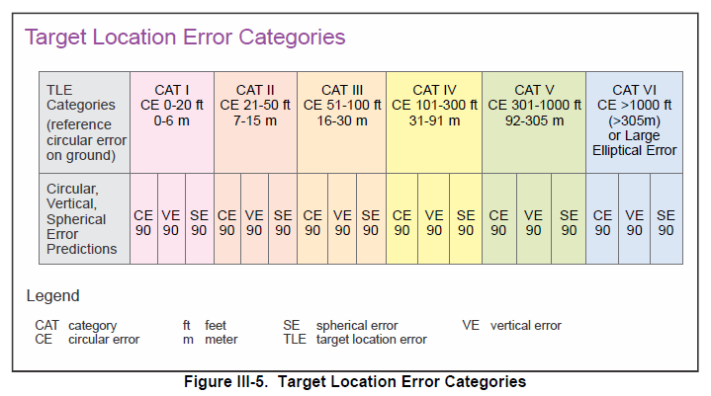
Target Location Error Categories

Slide 18
MILITARY KILL EFFECTS
Definition: destructive effects available upon detonation of a weapon.
KILL EFFECT |  | DEFINITION
BLAST |  | The high-pressure shockwave created by an explosion, traveling outward from the detonation point. Blast effects cause destruction by overpressure (compression force) and dynamic pressure (wind generated by the expanding gases), which can demolish structures, damage equipment, and injure personnel.
FRAGMENTATION |  | The dispersal of shrapnel or debris from an exploding munition. Fragments are propelled outward at high velocity, targeting personnel, equipment, and light structures in the area of effect.
PENETRATION |  | The effect of a munition or projectile piercing a target's surface without fully passing through it. Penetration is often used to defeat hardened targets, such as bunkers, by transferring energy into the target's structural layers.
INCENDIARY |  | The combustion of materials caused by incendiary munitions, secondary explosions, or the heat from a blast. Fire destroys flammable materials and can cause secondary damage to structures and equipment, as well as injuries to personnel.
CRATERING |  | The formation of a crater in the ground caused by the impact or detonation of a munition. Cratering disrupts mobility and operations, damaging roads, runways, or creating obstacles in the battlefield.
PERFORATION |  | The complete passage of a munition or projectile through a target, creating both an entry and exit point. Perforation may reduce the energy transfer to the target, making it less effective for destroying heavily armored or reinforced structures.
EARTH SHOCK |  | The seismic-like vibrations transmitted through the ground from an explosion. Earth shock can damage underground structures, destabilize foundations, or incapacitate personnel in subterranean environments.
NUCLEAR RADIATION |  | The release of ionizing radiation (alpha, beta, gamma, and neutron particles) from a nuclear explosion. Nuclear radiation can cause immediate biological damage, long-term health effects, and contamination of the environment.
THERMAL RADIATION |  | The intense heat and light energy emitted by an explosion, especially in nuclear detonations. Thermal radiation causes burns, ignites materials, and can create secondary fires in the target area.

Slide 19
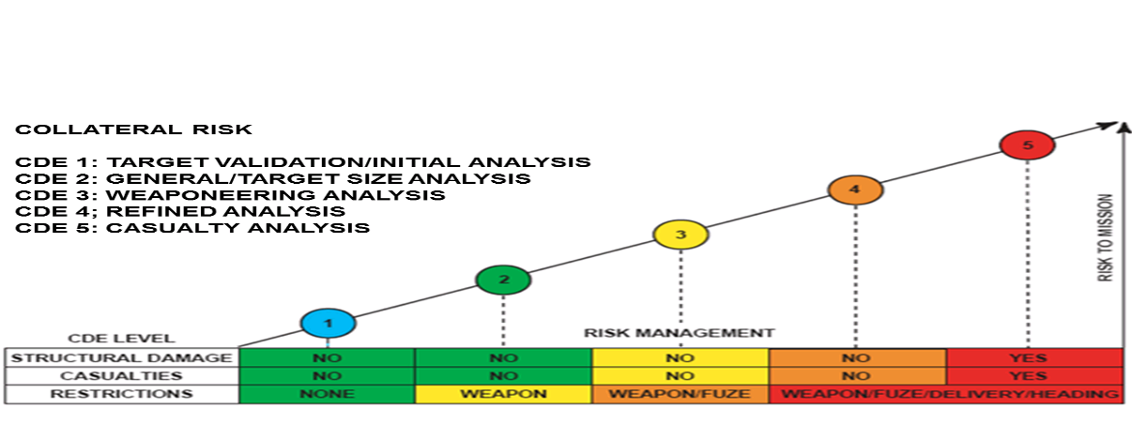
Collateral Damage Estimation Levels

Slide 20
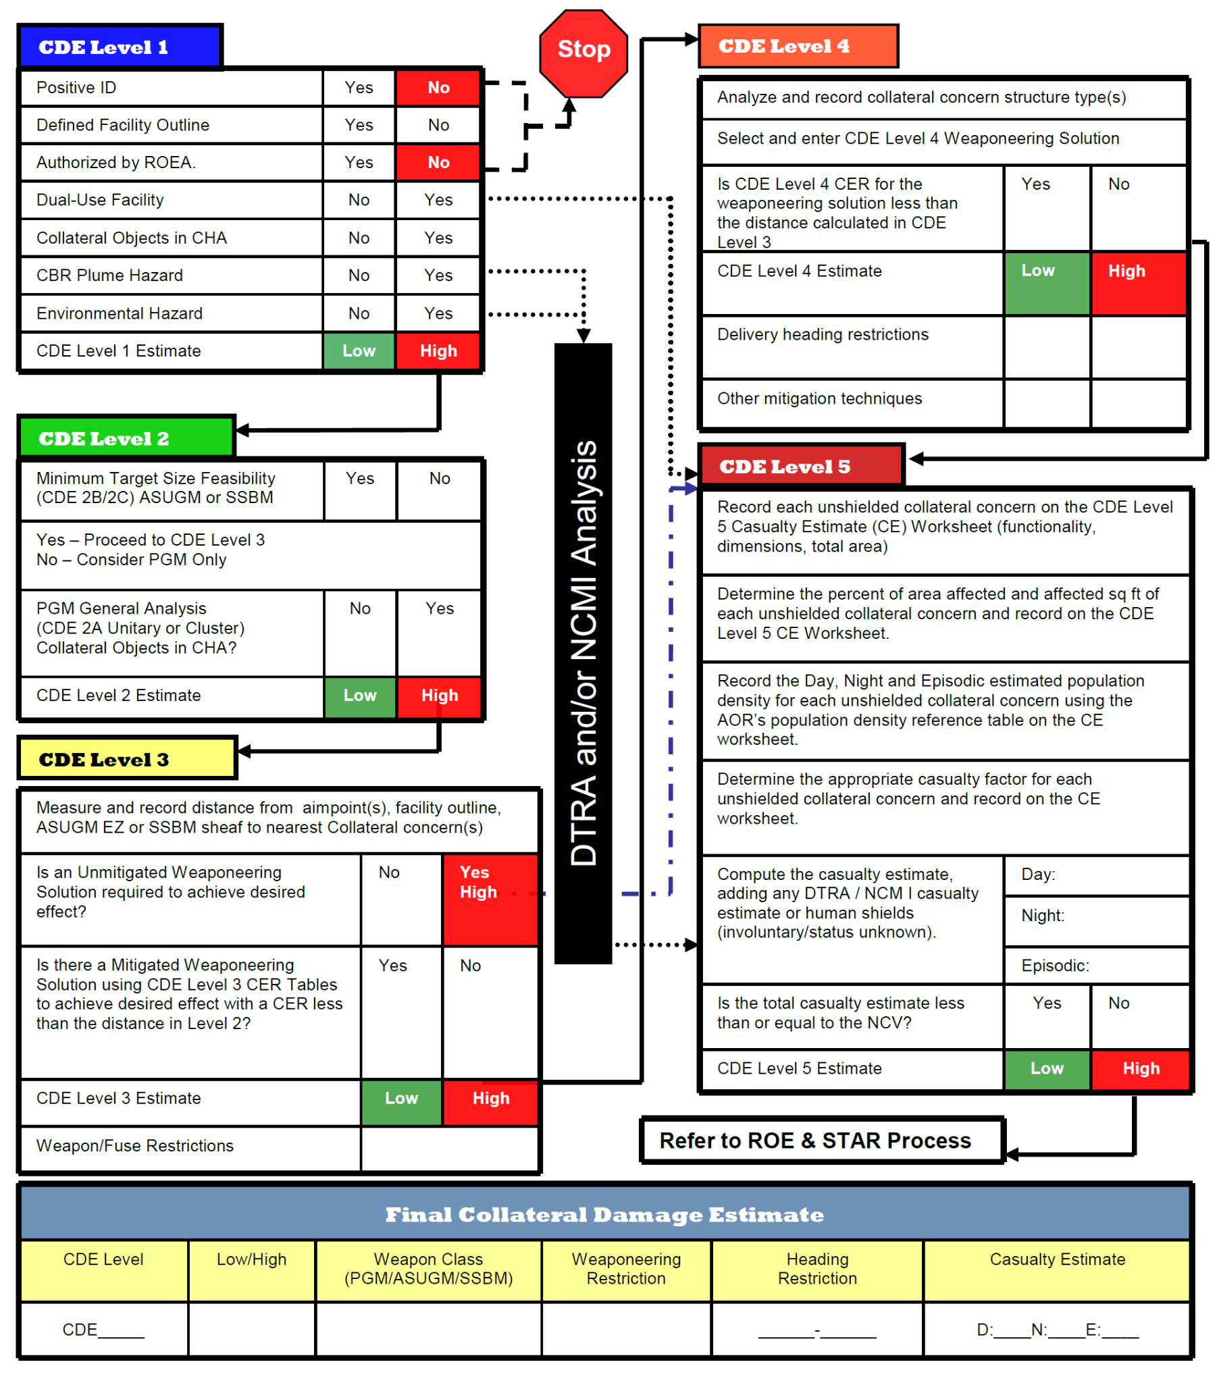
Collateral Damage Estimation Methodology

Slide 21
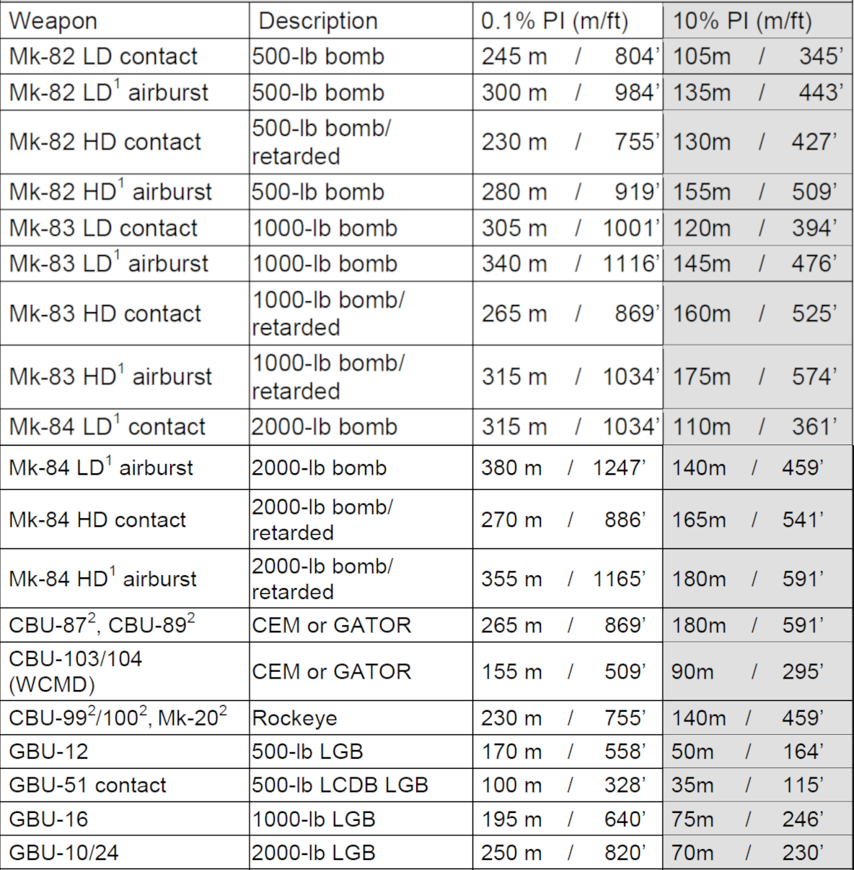
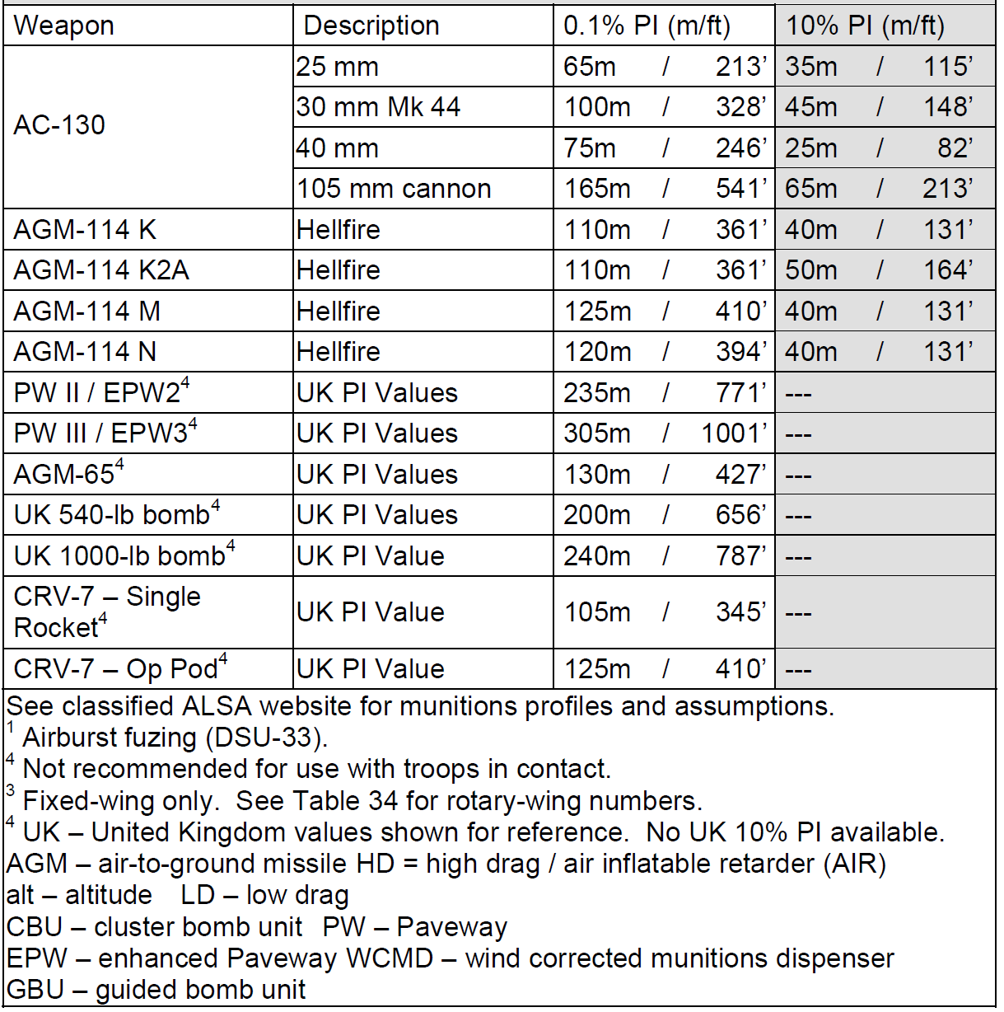
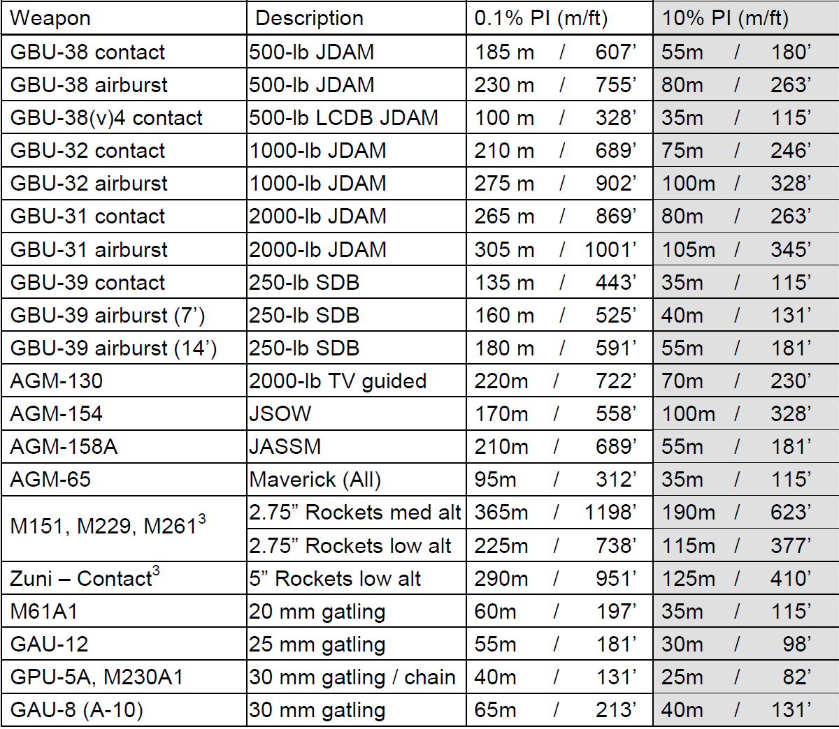
Risk Estimate Distance Table
(Fixed-Wing, 2007)

Slide 22
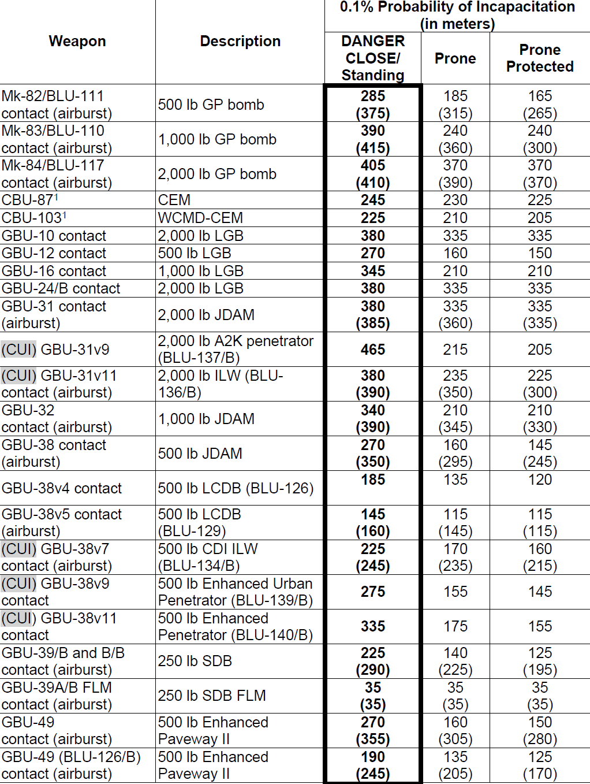
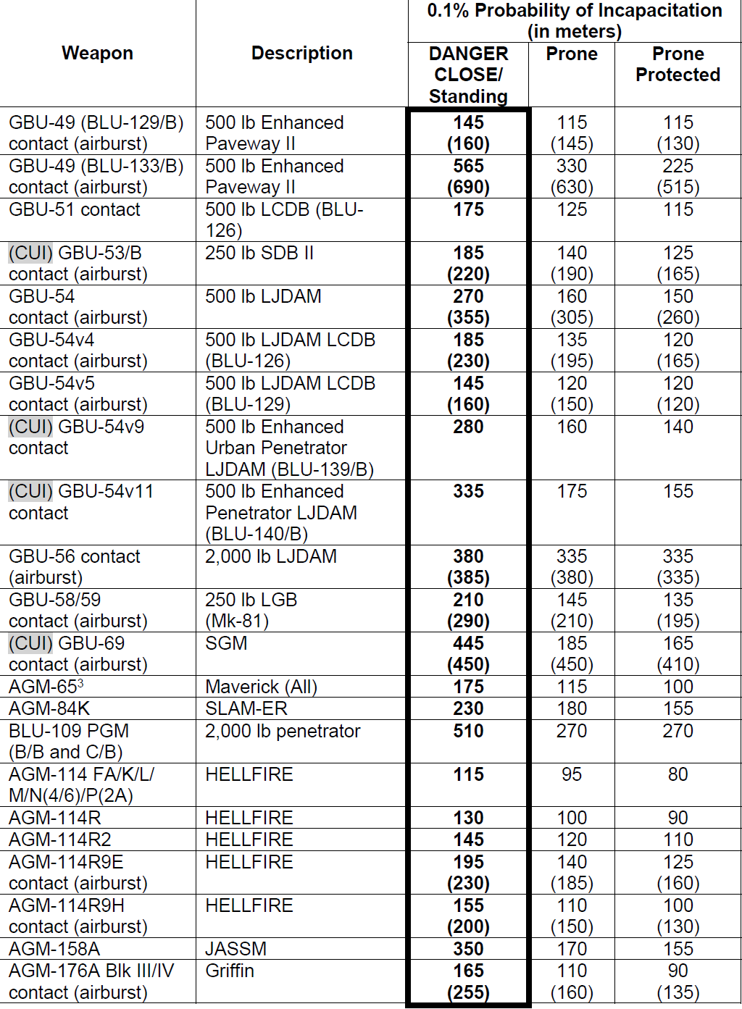
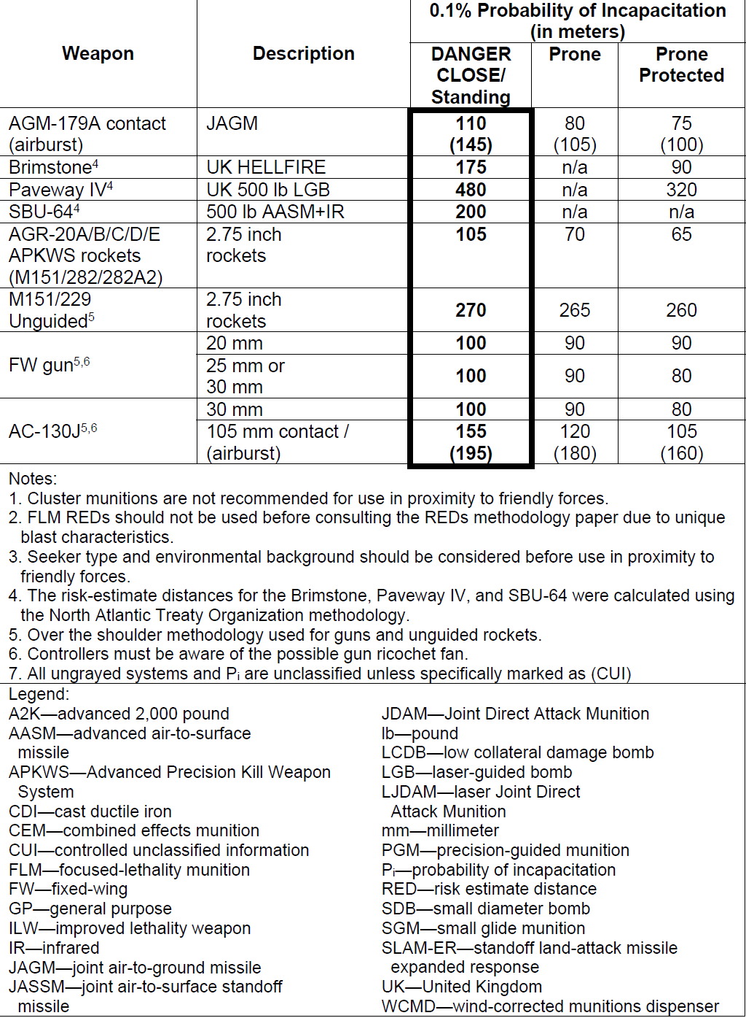
Risk Estimate Distance Table
(Fixed-Wing, 2023)

